Slide 1


WHO HIV testing strategies and algorithms and Quality management systems in diagnostics and testing
Alaleh Abadpour; WHO HIV Testing Services (HTS), Global HIV, Hepatitis, STI Programmes (HSS), Testing, Prevention and Populations (TPP) Unit

Slide 2


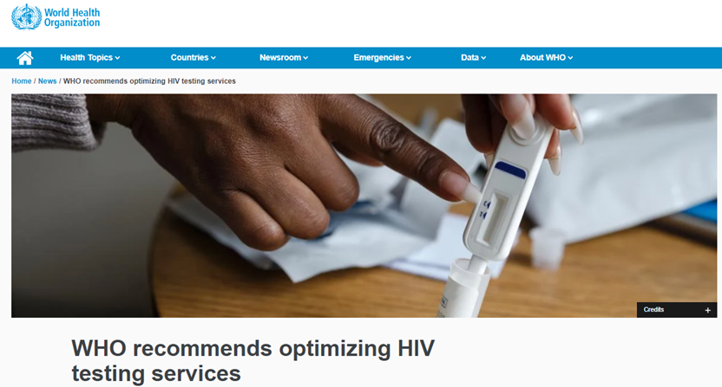
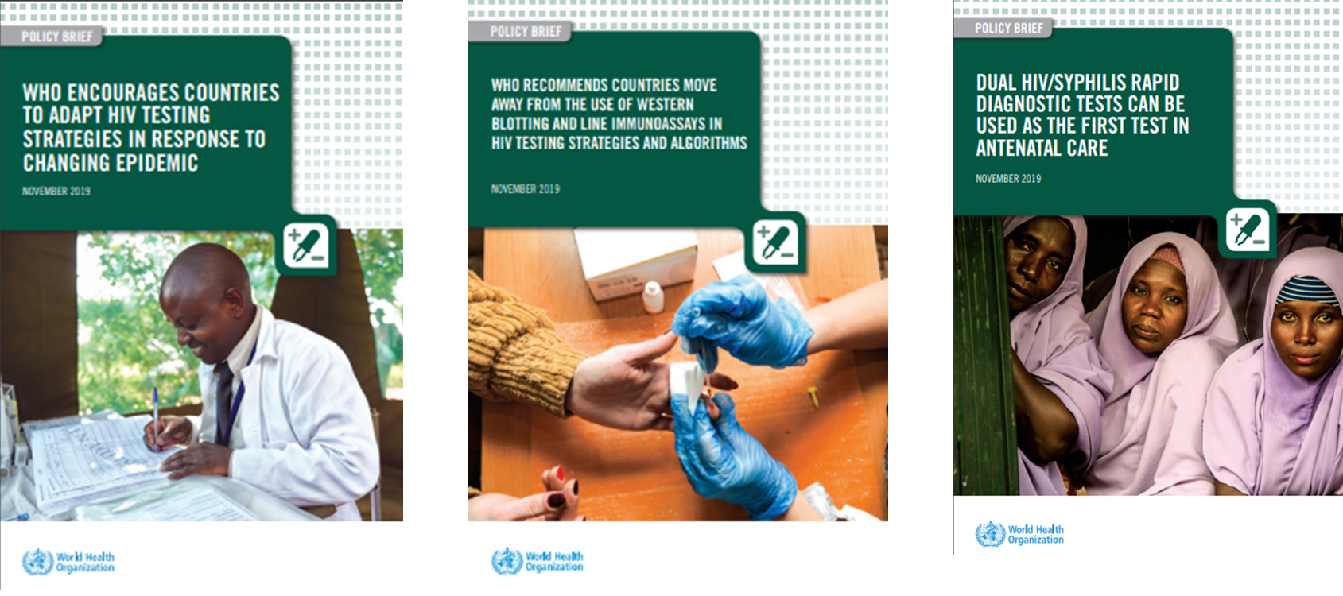
Presentation Outline
.
Current Epi Context and Evidence and Rationale for Using WHO HIV Testing Strategies and Algorithms, 2019
  The 3-test strategy: 3 consecutive reactive tests for a positive diagnosis
  Dual HIV-syphilis test in ANC and Key population settings
  Retesting before ART initiation
Quality management systems in testing sites
Process to update HIV testing strategy and algorithm
Universal 3 tests strategy
Moving away from WB/IB
Dual HIV RDT in ANC (and now KP) settings

Slide 3
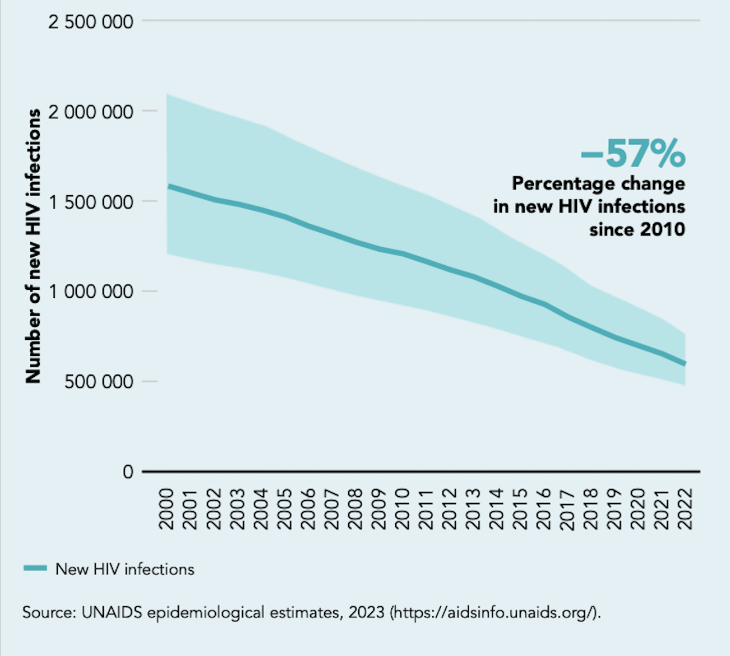
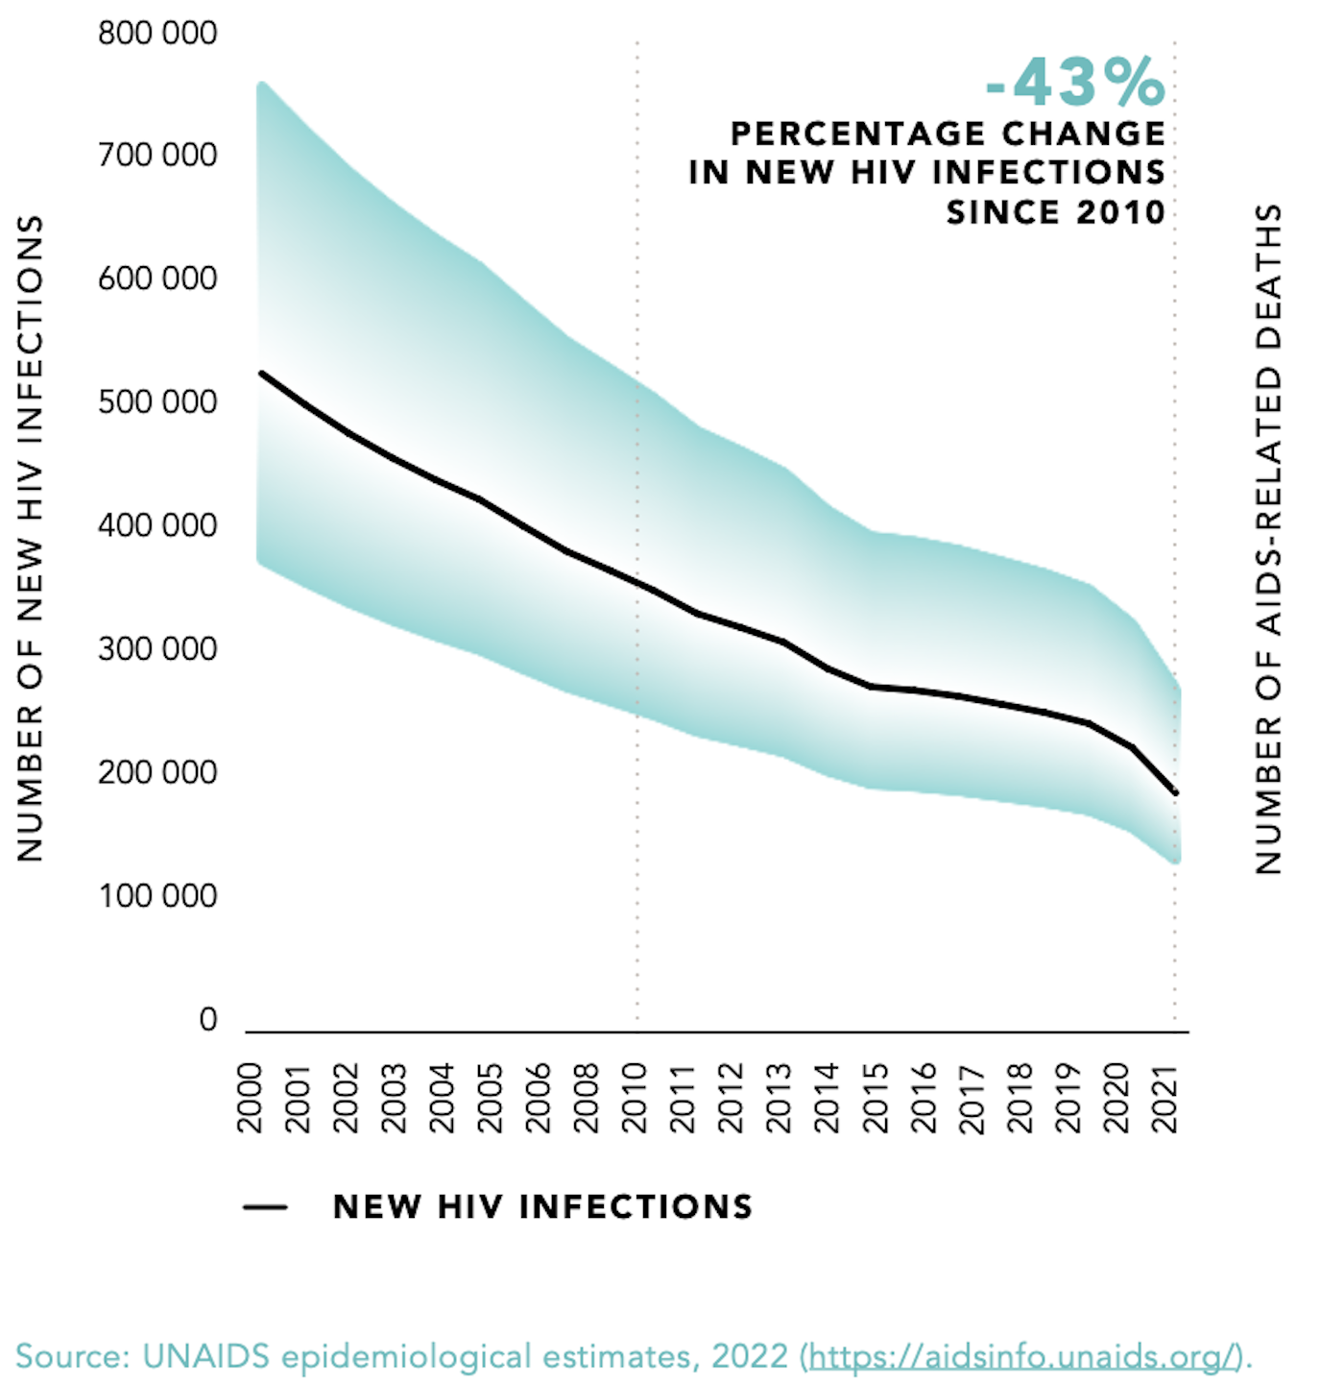
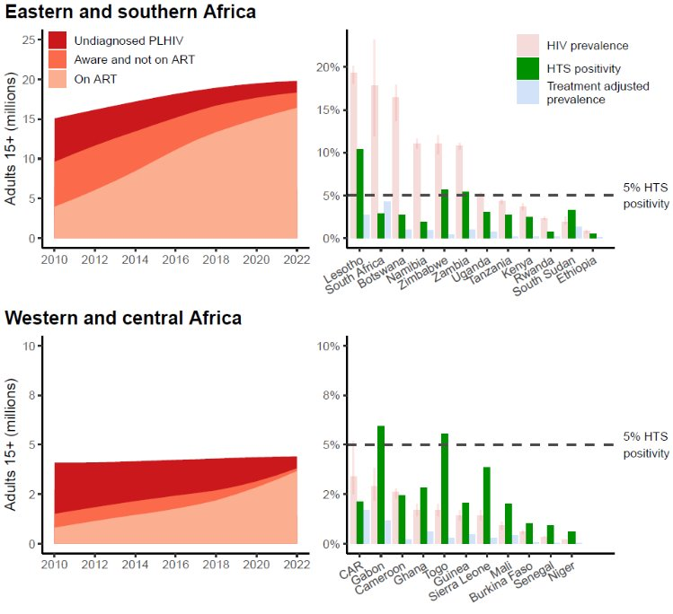
Declining treatment-adjusted prevalence and positivity and Reductions in the number of new HIV infections
2000-2021
.
.
Treatment-adjusted prevalence and HTS positivity rate has declined below 5 most in most of the countries (high and low burden) and will continue to decline as we reach closer to the 1st 95
West and Central Africa
Eastern and Southern Africa
72% of reporting countries have revised testing guidance to implement a 3-test strategy as recommended by WHO
76% of reporting countries are on track to procure for a 3-test strategy in 2024/2025.
Additional countries are also in the process of planning their transition, some of which may be included in the Next Gen Marketing SI.
Source: Global fund reporting
Source: UNAIDS 2023 estimates and UNAIDS GAM reporting
Treatment-adjusted prevalence
Notes:
There are no countries in West and Central Africa that have a positivity rate of above 5%.
Therefore, we strongly recommend that countries in this reason plan for switching to using three HIV-reactive test results to confirm a HIV-positive diagnosis.
Efforts need to be re-doubled to decrease the number of people living with HIV who remain undiagnosed.

Slide 4
Adapting National HIV Testing Strategies
Selection of test kits
.
Quality-assured assays, such as WHO prequalified, should be used:
  A1: >99% sensitivity: fewer than 1 ‘false negative’ for 100 truly positive
  A2: >98% specificity: fewer than 2 ‘false positives’ for 100 truly negative
  Either rapid diagnostic tests (RDTs) or enzyme immunoassay (EIA, CLIA, ECL)
WHO is encouraging countries currently using two consecutive reactive tests for an HIV-positive diagnosis to move toward using three consecutive reactive tests for an HIV-positive diagnosis. This is increasingly important as treatment-adjusted HIV prevalence and national HTS positivity continue to decline over time.
Ensure that the testing strategy has a positive predictive value ≥99% (PPV)
  Meaning of the persons classified as HIV+, ≥99% will truly be living with HIV
  PPV depends on the positivity rate among the testing population
conduct a verification study of the new testing algorithms to:
Identify the combination of products that have minimum possible common cross-reactivity to reduce the risk of false HIV-positive diagnosis. (Note: Products from the same manufacturer should not be used as part of the testing algorithm to minimize common cross-reactivity)
Identify flexible algorithms: replacement tests in case of a "problem" with one of the selected tests, e.g. stock out, lot recall, etc
Not intended to reevaluate the sensitivity and specificity of individual products!
Correctness of the final HIV status is dependent on:
  Specificity of the individual products used (for A1, A2, A3), and
  The probability that any specimen that is falsely reactive on the first assay (A1) is not also falsely reactive on the second assay (A2) and third assay (A3) – this can vary by region

Slide 5
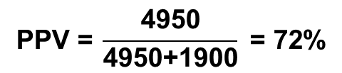



Rationale for the 3-assay testing strategy: PPV and number of assays
Probability of correctly being classified as HIV positive (assuming 99% sensitivity; 98% specificity
 | After 1 assay | After 2 assays | After 3 assays
HIV positive specimen | 0.99 | 0.99 x 0.99 = 0.98 | 0.99 x 0.99 x 0.99 = 0.97
HIV negative specimen | 0.02 | 0.02 x 0.02 = 0.0004 | 0.02 x 0.02 x 0.02 = 0.000008
After 1 assay
After 2 assays
After 3 assays
5,000 HIV+ specimens
x 0.99
4950 reactive
x 0.99
4901 reactive
4851 reactive
x 0.99
100,000 specimens tested;
5% prevalence
95,000 HIV– specimens
x (1-0.98)
1900 reactive
x (1-0.98)
38 reactive
x (1-0.98)
0.8 reactive
**Simplified algorithm - consecutive reactive HIV tests only

Slide 6
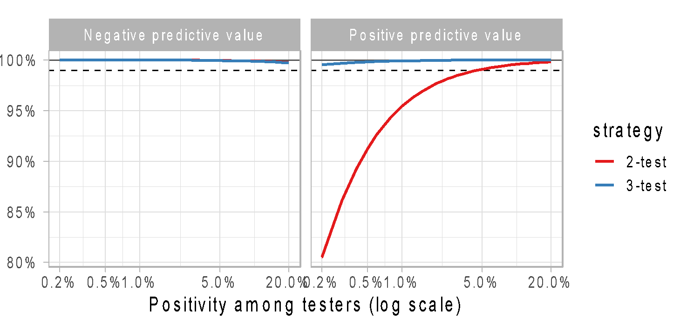
PPV depends on the positivity rate among testers
Outcomes per 100,000 tested
Assuming assays perform at or above 99% sensitivity; 98% specificity. Consecutive HIV tests only
Prevalence among testing population | Per 100,000 tested | After 1 assay | After 2 assays | After 3 assays
10% | 10,000 HIV+ 90,000 HIV- | 9900 true+ (99%) 1800 false+ (2%) 85% PPV | 9801 true+ 36 false+ 99.6% PPV | 9703 true+ 0.7 false+ 99.9% PPV
5% | 5000 HIV+ 95,000 HIV- | 4950 true+ 1900 false+ 72% PPV | 4901 true+ 38 false+ 99.2% PPV | 4851 true+ 0.8 false+ 99.9% PPV
1% | 1000 HIV+ 99,000 HIV- | 990 true+ 1980 false+ 33% PPV | 980 true+ 40 false+ 96% PPV | 970 true+ 0.8 false+ 99.9% PPV
0.1% | 100 HIV+ 99,900 HIV- | 99 true+ 1998 false+ 5% PPV | 98 true+ 40 false+ 70% PPV | 97 true+ 0.8 false+ 99.1% PPV
NPV and PPV
3-test strategy maintains a PPV of at least 99% for both high and low HIV testing positivity rate settings
Notes:
The lower the positivity rate, the more likely the chance that a reactive test result might be a false reactive.
This is why I don’t refer to false reactive results but false HIV-positive status.
We constructed a HIV testing strategy that minimizes the potential for a person to be falsely diagnosed as HIV-positive.
As you can see here in the most right column, with three HIV-reactive test results – we have a high PPV over 99% FOR BOTH HIGH and LOW positivity rate.

Slide 7
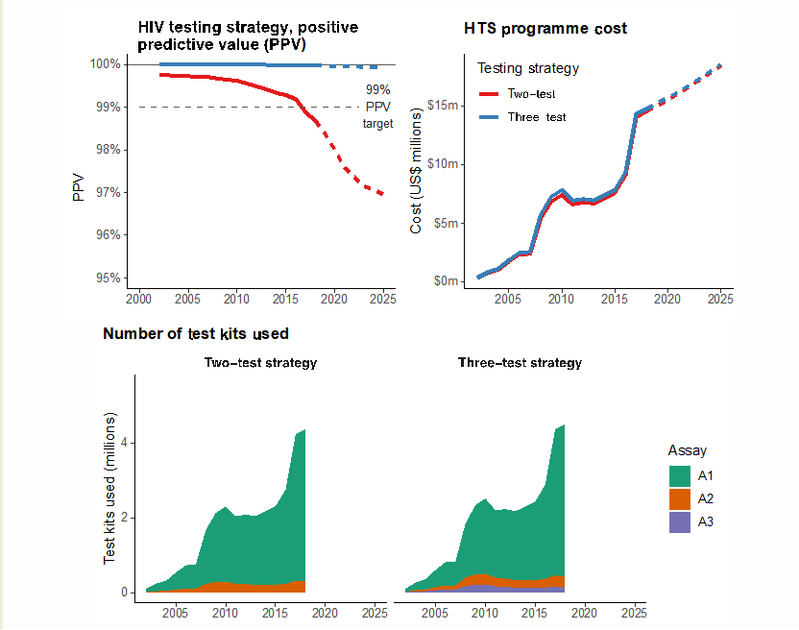
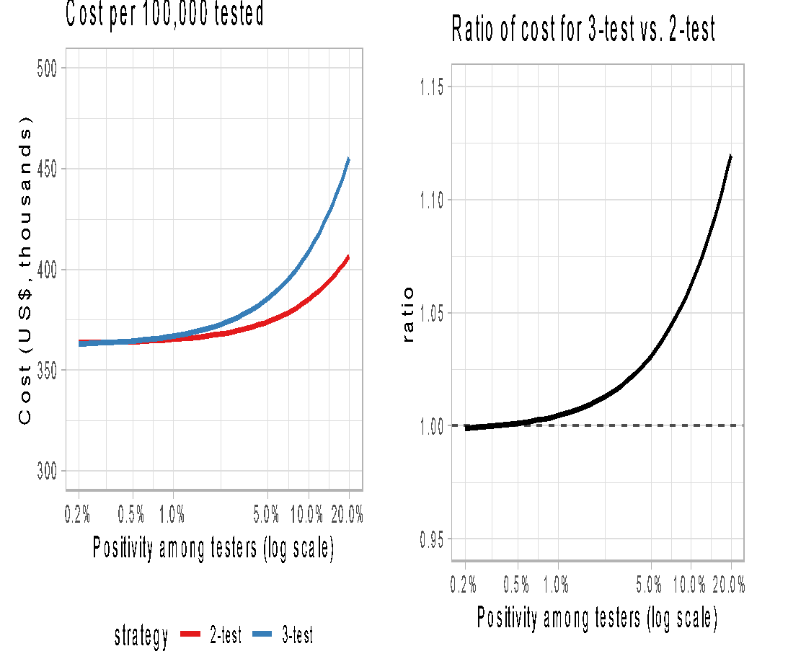
Difference of cost between algorithms
Malawi example
The cost of testing is mainly linked to the A1 test Adding a 3rd test does not significantly change the overall cost

Slide 8
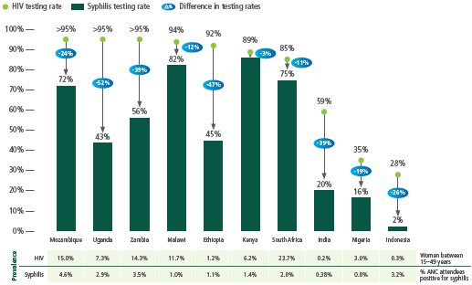
Syphilis testing and treatment coverage
The coverage is low among pregnant women in many countries, and many settings lower than antenatal HIV testing and treatment
The use of dual HIV/syphilis RDT is a new opportunity to close the gap between HIV and syphilis testing among pregnant women
Differences in coverage of testing for HIV and syphilis in pregnant women visiting ANC in 10 countries, 2016–2018
Figure credit: CHAI, https://www.thelancet.com/journals/langlo/article/PIIS2214-109X(19)30248-7/fulltext
Notes:
Appreciate the CDC’s efforts on the PT for Syphilis and hope that this could be a basis for further collaboration for QMS
Syphilis testing and treatment coverage among pregnant women are low in many countries, lower than that of antenatal HIV testing and treatment
While WHO recommends testing at the point of care using RDTs, the majority of countries still rely on laboratory testing for syphilis. Use of dual HIV/syphilis RDTs offers the opportunity to immediately close the gap between HIV and syphilis testing among pregnant women, with the goal of eliminating adverse birth outcomes due to syphilis.
ADDITION: Later in the webinar we will hear review with colleagues from Kenya the Kenya experience in introducing dual tests for HIV and syphilis and closing the testing gap. Dual HIV/syphilis RDTs may simplify logistics and procurement, and HIV funders are willing to purchase dual tests to cover investment gaps

Slide 9
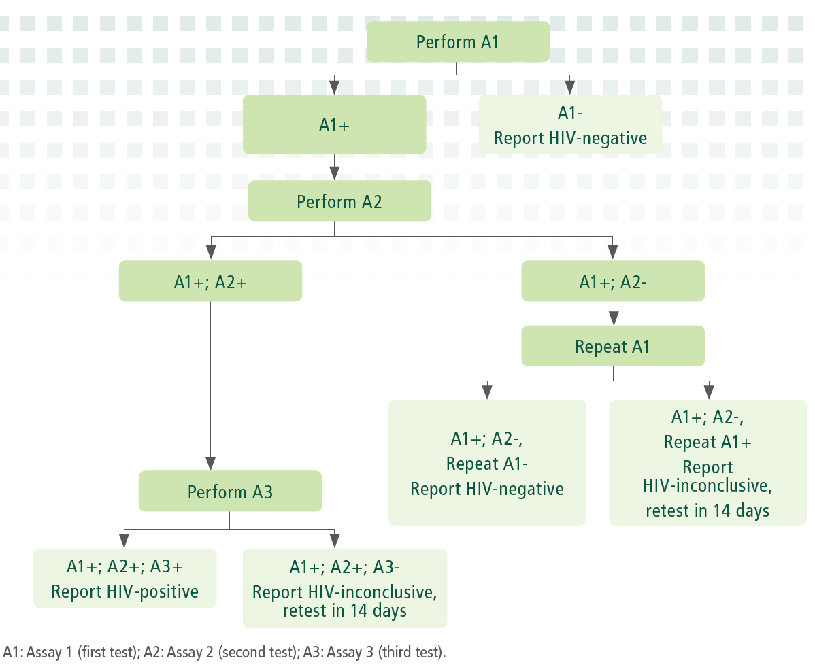
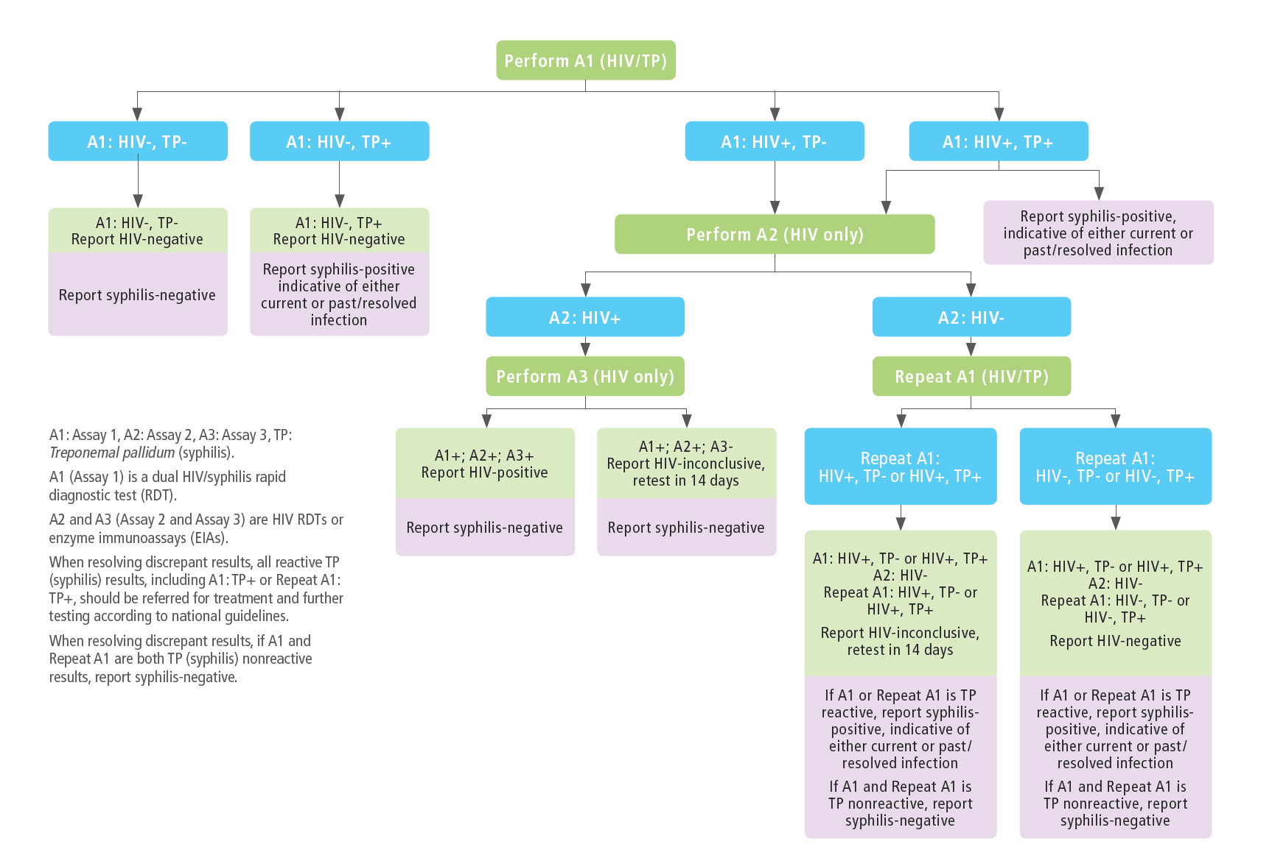
WHO 3-assay HIV Testing Strategy
–3 consecutive reactive tests for an HIV positive sero-diagnostics
.
Other settings: HIV standalone tests
ANC settings and KP: dual HIV-Syphilis test for A1

Slide 10

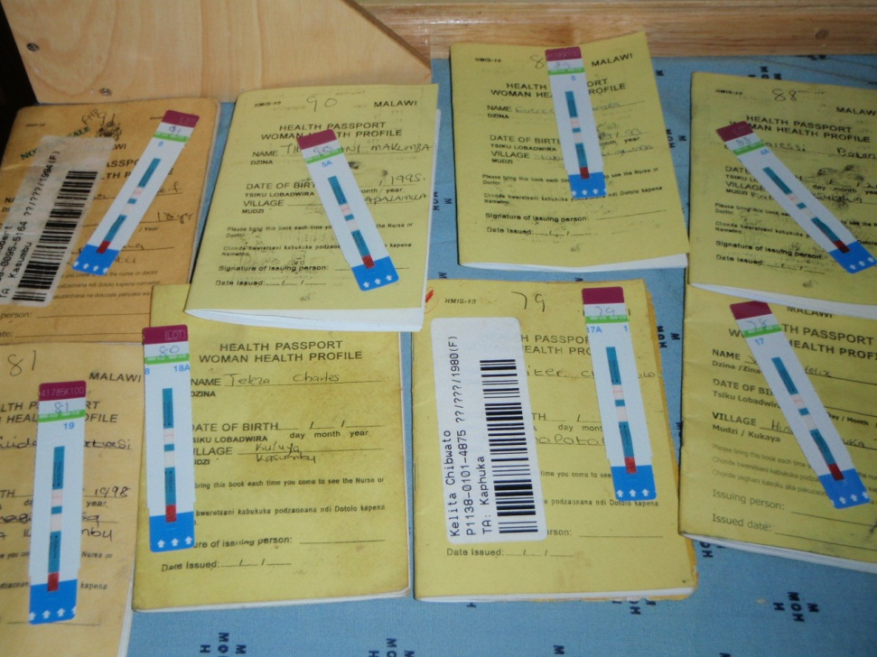
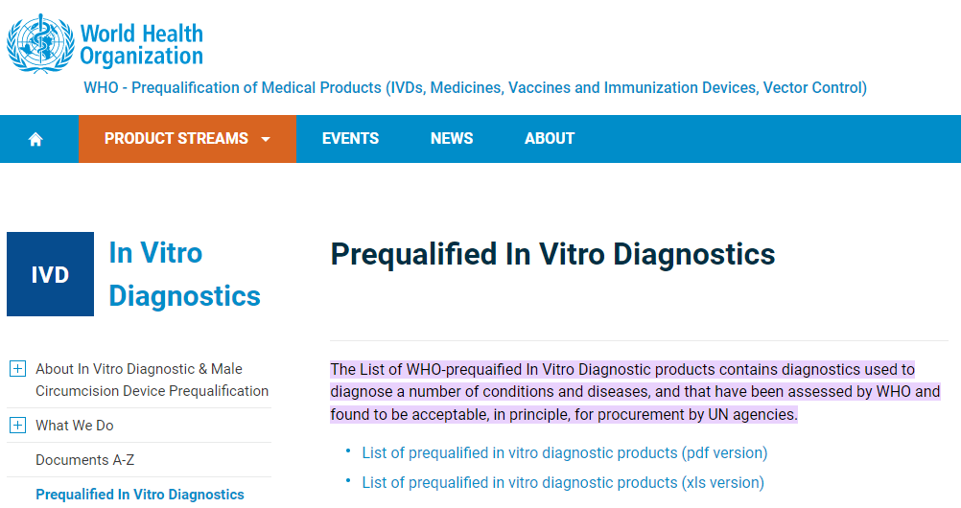
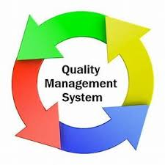
WHO’s effort to reinforce Quality Assurance (QA)
QA within QMS is vital for all HIV testing services across different settings and reflects an ethical obligation
Re-test a patient before ART
using the same algorithm (verified PPV )
Avoid: stigma, violence, trauma, and lack of trust in testing services
High-quality RDTs and EIAs
Ideally in a different site or a different tester
Does not replace the need for 3 test strategy
Diagnostic errors:
Human errors
quality with a batch
change in national algorithm
34 different WHO PQed products available for procurement:
21 HIV RDTs: at least 99% sensitivity and 98% specificity
4 EIAs
Dual HIV/Syphilis RDTs
6 HIV-ST: 1 Oral fluid and 5 blood-based
- The cost of ART for one HIV-negative person >>> cost of redoing the algorithm
- It takes 9,6 months to recoup the investment in retesting in a country where prevalence =10%.
Source: https://extranet.who.int/pqweb/vitro-diagnostics/prequalification-reports/whopr?field_whopr_category_tid=58
Notes:
Retesting objective: To address through the implementation of robust QMS
Objective: Identify potential diagnostic errors before THE patient is put on treatment because afterward, it will be very difficult to identify him (VL neg)

Slide 11
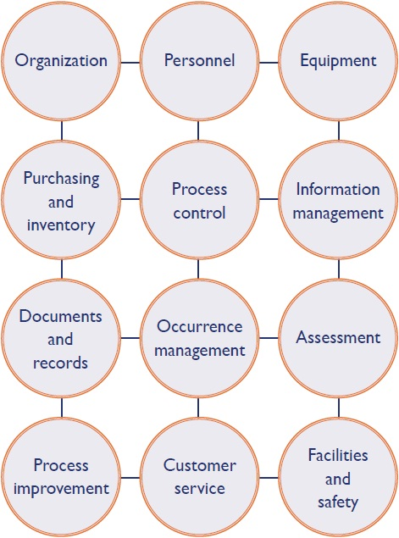






What is QMS in testing services?
Recent reports suggest that the quality of HIV testing may be suboptimal in many settings leading to Misdiagnosis of HIV status – both false-positive and false-negative
QMS encompasses organizational processes aimed at ensuring the quality, accuracy, and reliability of testing services.
The Quality System Essentials (QSEs) framework consists of 12 building blocks that are crucial for ensuring quality.
Each pillar represents a vital element of the testing process, and their correct management is essential for accurate and reliable results.
It includes Quality Assurance (QA), Quality Control (QC), and Quality Improvement (QI).
The focus is on process quality, not just the product used for testing (IVD).
Ministries of health should establish robust QMS for their HIV testing services.
What to do at the national level
1. NATIONAL POLICIES, STRATEGIC PLANS, M&E FRAMEWORK: NATIONAL AUTHORITIES TO SUPPORT QMS AT TESTING SITES.
2. WORKFORCE DEVELOPMENT: TESTING PROVIDERS ARE TRAINED AND SUPPORTIVELY SUPERVISED.
3. TESTING STRATEGIES AND ALGORITHMS: ADOPTING WHO-RECOMMENDED TESTING STRATEGY (VERIFIED TESTING ALGORITHMS).
4. PRE-MARKET ASSESSMENT: USING WHO’S PREQUALIFICATION LISTING, STRENGTHENING REGULATORY CAPACITIES.
5. POST-MARKET SURVEILLANCE: REPORTING COMPLAINTS AND PARTICIPATING IN EQA SCHEMES.
6. PROCUREMENT AND SUPPLY CHAIN MANAGEMENT: ENSURING UNINTERRUPTED SUPPLY AND APPROPRIATE STORAGE OF TEST KITS.
7. ACCREDITATION OF TESTING SITES: ENSURING TESTING SITES ARE SUPPORTED AND ARE HELD TO A STANDARD OF QUALITY
Notes:
quality of testing is one activity that is endorsed but the WHO drag task force; 1st stakeholder consultation done las week has shown: a tool kit specific to non lab setting will help to implement QMS in non lab settings (simplified), we need to integrate multi diseases, need to include a module for national level activities.

Slide 12
Algorithm transition Process
.
Preparation verification study
Conducting verification study
Pilot
(at the discretion of the country)
Develop study protocol, seek ERB approval
Shortlist 8-12 candidate products (including dual tests)
Request/order test kits
Select study sites (collection and testing sites)
Develop study tools (SOPs, data collection, training material, etc)
Establish verification panel : prospective collection (n=230 negative specimens)
Test each candidate product (2 lots) with the verification panel
Interpret and analyze results
Choose HIV testing algorithms (including replacement tests)
Update tools (SOPs, training modules, data collection, etc)
Run new HIV testing algorithm
  High-volume sites: 2 weeks
  Low-volume sites: 4 weeks
Assess feasibility and acceptability
Roll out HIV testing algorithm(s) more widely
Ordering time
8- 12 weeks
6- 8 weeks
6-8 weeks
Timeline will be context specific and will vary country by country
Ordering time
https://www.who.int/tools/optimizing-hiv-testing-algorithms-toolkit: Verification tool kit
Notes:
Here is an overview of the key steps for the verification study:
Some of these steps can proceed in parallel but our experience, the most time consuming step is to order the test kits and other reagents and consumables.
As we are collecting negative specimens, it should not be as difficult as other types of studies that are generally looking for positive specimens which are less common.
We will know dive deeper into each of these steps.

Slide 13



Conclusions
Testing strategies should reflect changes in epidemiology:
  3-assay testing strategy substantially reduces false-positive misclassifications to ensure that the 99% PPV target is achieved.
  Increases ‘inconclusive’ results (A1+/A2+/A3-), but most will be confirmed negative at day 14 (a good thing).
  Incremental budgetary impacts are low:
Cost of the 3- vs. 2-test algorithm are similar; switching to 3 test strategy doesn’t substantially increase costs
Retesting before ART initiation remains cost-saving
Quality management systems:
Ensuring accurate HIV test results is a priority, aligned with WHO's 5 Cs for HIV testing regardless of the type of testing site and who are the testers (profile)
WHO is working on finding new ways to optimize the quality of testing across multiple diseases
Supporting countries to Incorporate QMS into their policies and testing guidance
The development of a QMS toolkit discussed during a recent webinar and technical and financial stakeholders showed immense interest
The diagnostic task force established to oversee the new tools developments and reinforce QMS capacities
https://www.who.int/health-topics/in-vitro-diagnostics#tab=tab_1
Simplified QMS toolkit
Notes:
5cs : (Consent, Confidentiality, Counselling, Correct results, and Connection

Slide 14
For more information on HIV testing services
WHO HIV Testing Services Dashboard
WHO HIV Testing Services Info App
WHO HTS GL
Questions?
Contact: Cheryl Johnson johnsonc@who.int
Céline Lastrucci lastruccic@who.int
Alaleh Abadpour: abadpoura@who.int

Slide 15
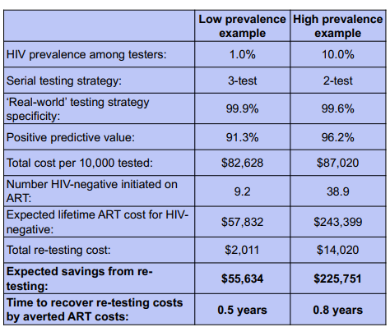
Re-testing costs and expected ART costs for misclassified HIV-negative adults
results per 10,000 tested
- The cost of ART for one HIV-negative person >>> cost of redoing the algorithm
- It takes 9,6 months to recoup the investment in retesting in a country where prevalence =10%.
- Avoid: stigma, violence, trauma, and lack of trust in testing services
Source: Eaton et al 2017 https://pubmed.ncbi.nlm.nih.gov/28872271/
Notes:
Source: systematic review
Remove line 3 and 4

Slide 16
Different types of retesting
WHO guidance covers different types of retesting:
Verification (prior ART): same algorithm twice, does not replace the need for a 3 test strategy
  Operationalization can be optimized; eg:
    Depriorization for: people coming after reactive HIV-ST or people identified as re-tester
    Prioritize some testing sites: bad performances, geography/sampling method: monitor overtime
diagnosis such as (after community A0 or HIV-ST) - full algorithm completed by a trained tester.
Resolving inconclusive diagnosis – people coming back after 14 days to resolve discordant results
Re-engagement (welcoming back): full algorithm once (except if person on ART) – may include counseling messages and discussions on reasons for retesting and support to re-link

Slide 17
NAT and HIV infection confirmation for adults and children >18 months
(1/2)
Questions are raised on potential use cases for NAT in HIV testing algorithms but some cautions:
  NAT tests should have a claim of “aid to diagnosis” as part of their IFU to potentially be used in the testing algorithm (only one WHO-PQ product has this). If not: “off-label use”. Quantitative tests(VL) are designed and regulated for monitoring not aid in diagnosis
  An undetectable NAT does not mean HIV neg: people on ART and PrEP might have an undetectable NAT test (in some settings, 30-50% % of people attending testing sites already know their status and are on ART)
  NAT to confirm HIV status (after 2 reactive serology tests):
    A third serology test would probably be reactive as well (less costly and reduces TAT compared to NAT)
    Undetectable NAT does not mean HIV neg
  NAT to resolve inconclusive status (discordant A1, A2 or A3 results):
    NAT reactive= confirmed HIV infection
    Undetectable NAT does not mean HIV neg. so the final result would still be inconclusive and need additional testing after 2 weeks (same outcome as serology)

Slide 18
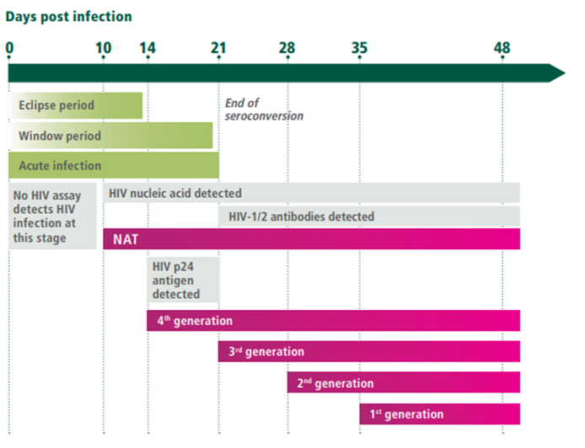
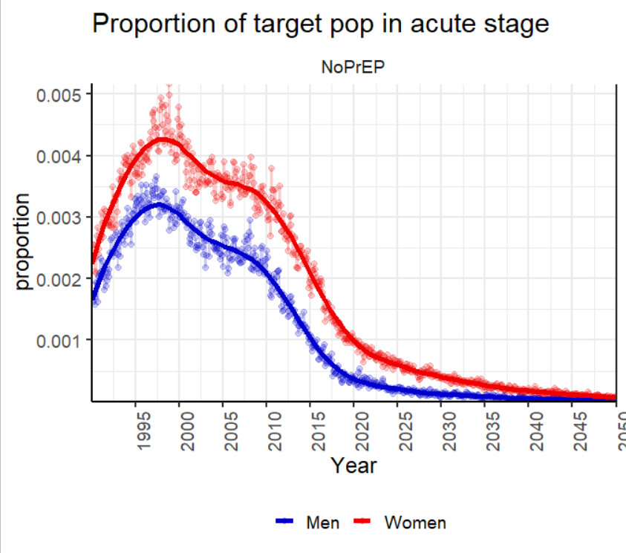
NAT and HIV infection confirmation for adults and children >18 months
(2/2)
3. NAT to find acute infection:
3rd generation Ab tests (IA and RDTs) detect from 21 days
4th generation Ab/Ag tests (IA and RDTs) detect from 14 days
NAT detect from 10 days (4 days before 3rd gen and 10 days before 4th gen
Source: Slide courtesy Monisha Sharma
Modeled acute infections as proportion of population (15-34 y/o)
Added value of NAT (but also 4th gen Ab/Ag) depends on the proportion of clients attending testing sites before 3rd generation tests become reactive: context dependent
To balance with need to increase access to testing to close the gap in 1st 95
Increase in False-Positive Fourth-Generation Human Immunodeficiency Virus Tests in Patients With Coronavirus Disease 2019 | Clinical Infectious Diseases | Oxford Academic (oup.com)
Notes:
, Globally as countries reach 95-95-95 and infections decline, acute HIV will also decline
\WHO does not recommend a specific brand. 3rd and 4th gen can be included in testing algorithm. we just want test to be quality assured

Slide 19
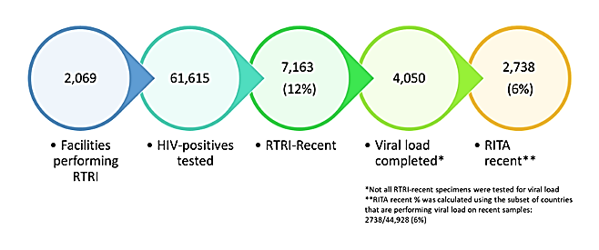
  Recency assay results from PEPFAR countries
“About 30%-50% of RTRI recent have suppressed VL and are reclassified as long term infections”
30-50% of person newly diagnosed HIV pos were already on ART
Graphic provided by Dr. Parekh (CDC Atlanta) in response to WHO request for information
Notes:
this slide is to show that we have quite a lot of people attending testing sites who know their status already (for the VL in algorithm discussion)

Slide 20


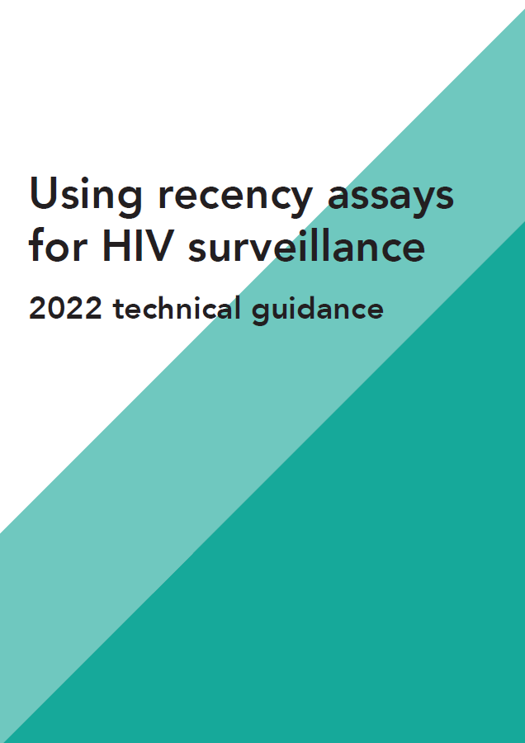
WHO does not recommend using recency assays in HIV testing services
Recency testing for surveillance
NO benefits of recency testing in routine HTS, 2023 HTS consolidated guideline
WHO recommends use of recency assays in surveillance
Utility of recency testing has been demonstrated in population-based surveys to measure HIV incidence
Use of recency testing in programmatic settings should only be considered when existing HIV testing coverage of the population being studied is high, when a combination of assays including viral load can be delivered to reduce false recent results and analysis plans make appropriate statistical adjustments and infer population-specific trends in recent infection
New WHO recommendation
HIV recency testing is not recommended as part of routine HIV testing services (conditional recommendation, low-certainty evidence)
Remarks
This recommendation calls for excluding recency testing from routine HIV testing services. HIV testing services are defined as a package of services including brief pre-test information and post-test counselling; linkage to appropriate HIV prevention, care and treatment services and other clinical and support services; and coordination with laboratory services to support quality assurance.
Recency assays can, however, be used for surveillance of HIV incidence. WHO has published guidance on this in Using recency assays for HIV surveillance: 2022 technical guidance (https://apps.who.int/iris/rest/bitstreams/1486096/retrieve
There are no WHO prequalified recency assays
  No WHO prequalified recency tests in the pipeline or planned to be in the pipeline for WHO prequalification at this time.
  No current pathway for recency testing to receive WHO prequalification as process reserved for recommended HTS interventions & diagnostic tests.
Notes:
Recency testing is a complex undertaking and has demonstrated utility in population-based surveys to measure HIV incidence. Use of recency testing in programmatic settings, however, should be considered only when existing HIV testing coverage of the population being studied is high, a cost-effective RITA can be implemented to reduce the number of false recent results, and analysis plans make appropriate statistical adjustments and infer population-specific trends in recent infection
The prior guidance stated: WHO does not recommend the use of recency assays for clinical use or management of people living with HIV or their partners. In this context, this includes return of results to clients; counselling messages about recent infection; and prioritizing initiation of antiretroviral therapy, partner services, index testing or additional services based on recency results

Slide 21
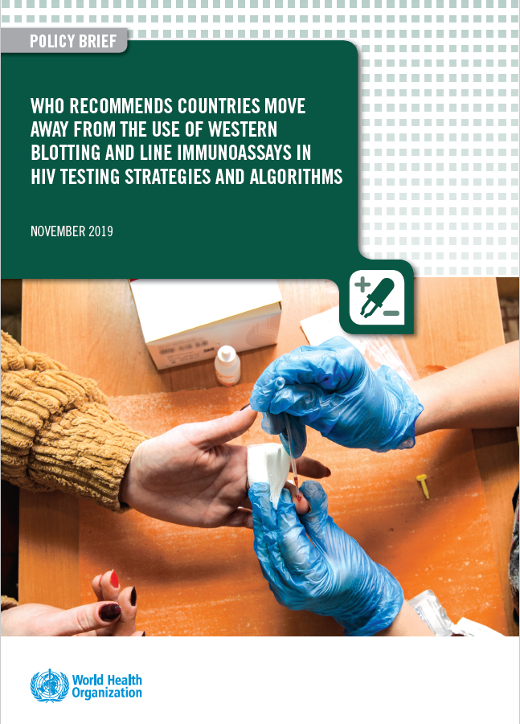
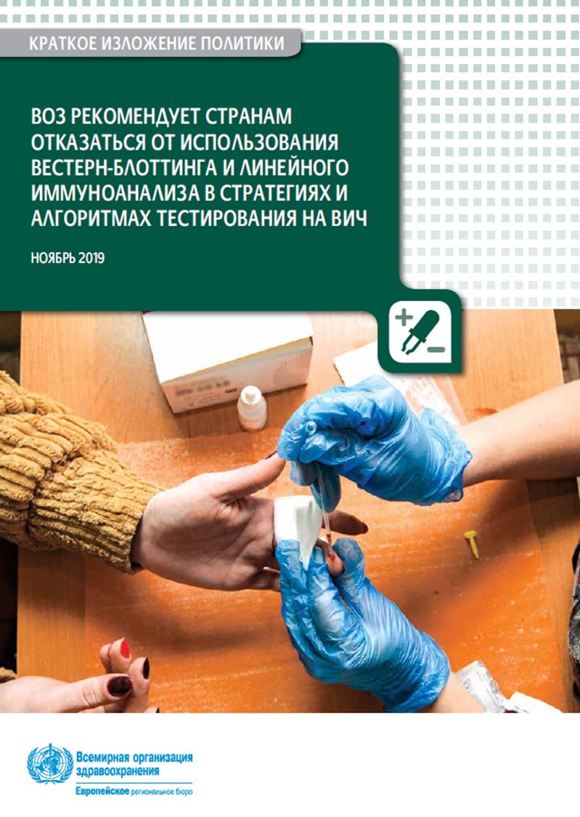
Moving away from WB:
A systematic review of published data
Pooled estimates from bivariate mixed-effects meta-analysis
 | Comparator (with WB/LIA) |  |  |  | Index (without WB/LIA)
 | Estimate | Std error | 95% CI |  | Estimate | Std error | 95% CI
Sensitivity (%) | 98.6 | 0.8 | 95.9 | 99.6 | 99.2 | 0.5 | 97.6 | 99.7
Specificity (%) | 99.9 | 0.1 | 99.7 | 100.0 | 100.0 | <0.01 | 99.7 | 100.0
Indeterminate | 81 |  |  |  | 0
Comparator (with WB/LIA) produced 81 indeterminate diagnosis
37 of 81 INDs (46%) were from specimens that were Positive
44 of 81 (54%) were from specimens that were Negative.
Performance:
Sensitivity and specificity is comparable
But high-rate indeterminate results with an algorithm containing WB
‹#›
Notes:
WHO conducted a systematic review on the clinical utility of western blotting and line immunoassays – so called confirmatory assays.
A confirmatory assay is by definition the result that rules out. If positive, the person is positive. If negative, the person is negative.
Given the superior performance of RDTs and immunoassays during seroconversion it is entirely likely that western blot might be negative with reactive RDTs or EIAs.
We found that the overall sensitivity and specificity of testing algorithms that used WB or LIA vs testing algorithms that did not was similar. But the rate of HIV-indeterminate results driven by HIV-negative or HIV-inconclusive blot results was significantly different.

Slide 22
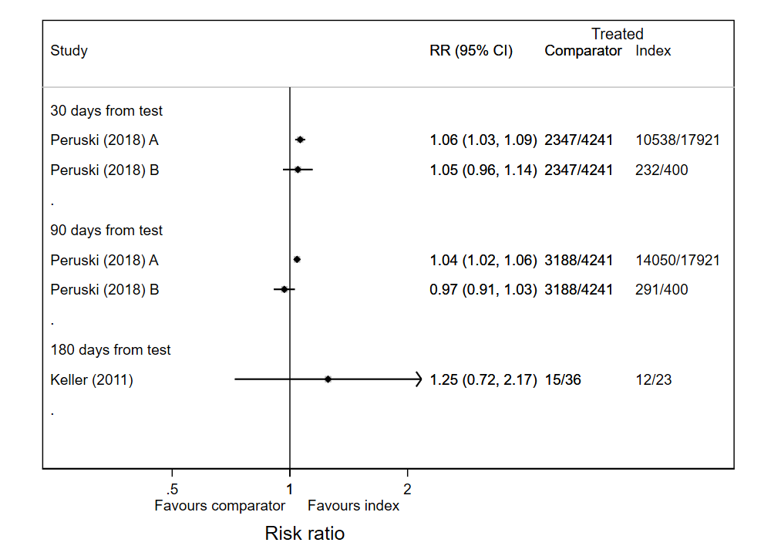
Moving away from WB:
Review of other outcomes (other than performance)
Programmatic outcomes: Longer time to diagnosis, higher loss to follow-up, and lower linkage to care with WB algorithms.
Values and preferences: Clients and providers favor algorithms without WB.
Feasibility: Treat all/rapid ART initiation and offer prevention (PrEP) difficult when using WB algorithm. WB testing requires skilled staff and certain equipment.
Resources use: More resources required for WB, all studies reported RDT to be substantially less costly than WB-based testing. Programmes report of cost savings.
Equity: Moving away from WB improves equity and uptake among PLWHIV who don’t know their status
Estimates of the risk ratios for the time to linkage-to-care after testing with the Index and Comparator algorithm
‹#›

Slide 23
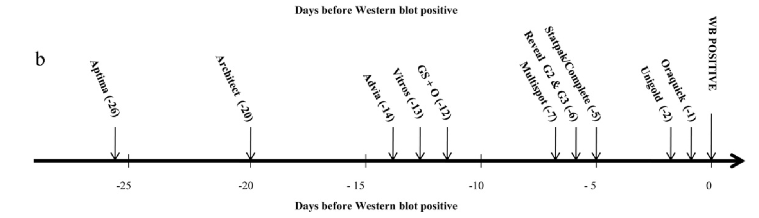
Early detection by RDT compared to WB
slide from Bharat Parekh, CDC – Atlanta presented in a join CDC/WHO meeting in EURO in 2021

Slide 24
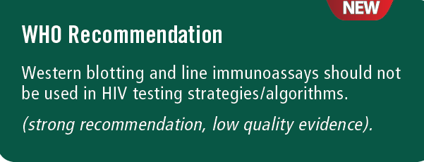
Why is it a priority to shift to HIV RDTs and
away from western blotting?
2019
Rate of diagnosis lower in EECA (62%)
  Need to increase access to testing (less centralized approaches have been proven highly efficient for that)
  KP and men are critical and unreached by current testing strategy (higher prevalence and more new infections)
Linkage rates to ART & PrEP suboptimal (< 51% PLHIV are on ART in EECA and 76% in WCE and north America)
  Need to have same day diagnosis and RDTs can do that (standard in all other regions globally)
Evidence on shortcomings of WB/LA very apparent
  Poorer sensitivity for early HIV infection vs RDT/IA
  Higher rates of HIV-inconclusive/indeterminate status
  Longer test procedure than RDTs/Ias, complex interpretation
  More hands-on time, more staff time which isn’t available and is costly
  Cost per test much higher than RDTs/IAs
Changing funding environment & new donor requirements
  WHO recommendation on HIV testing strategy is a Global Fund programme essential for GC7
  SAGE IVD negative listing for WB
Source: WHO 2019

Slide 25
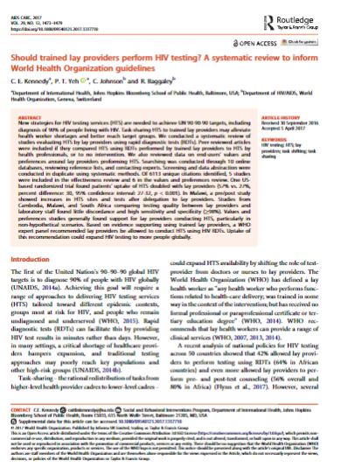
Why lay provider testing and rapid testing?
Better uptake & prefered by clients (especially KP) = more people know their status
  Lay provider vs HCW: 57% vs 27% (95% CI: 27–32,p< .001)
  In all studies individuals preferred RDTs over lab-based methods (EIA & WB)
Low cost & affordablity
  Using lay providers is less costly and more feasible across HTS sites
  Using RDTs less costly overall & shown to be cost-saving compared with laboratory methods
Accurate diagnosis
  Lay provider HTS equivalent accuracy to HCWs RDTs and equivalent to laboratory methods (EIA/WB)
  Fewer indeterminate/inconclusive results = easier messaging & more people able to start ART and PrEP faster which is key
  Labs still have important work to provide support & supervision for HTS – shifting to RDTs and lay providers doesn’t takeaway but adds to their work
Same day start
  RDTs have much faster turnaround time than lab-based testing
  RDTs enable decentralization of confirmation testing which is key
  People get to start PrEP & ART same day
Many countries (mainly in ESA) have reached or are near to reaching –RDTs made it possible
Source: Wagner 2023; Derksen 2015; Kennedy 2017; WHO 2019

